Slide 1
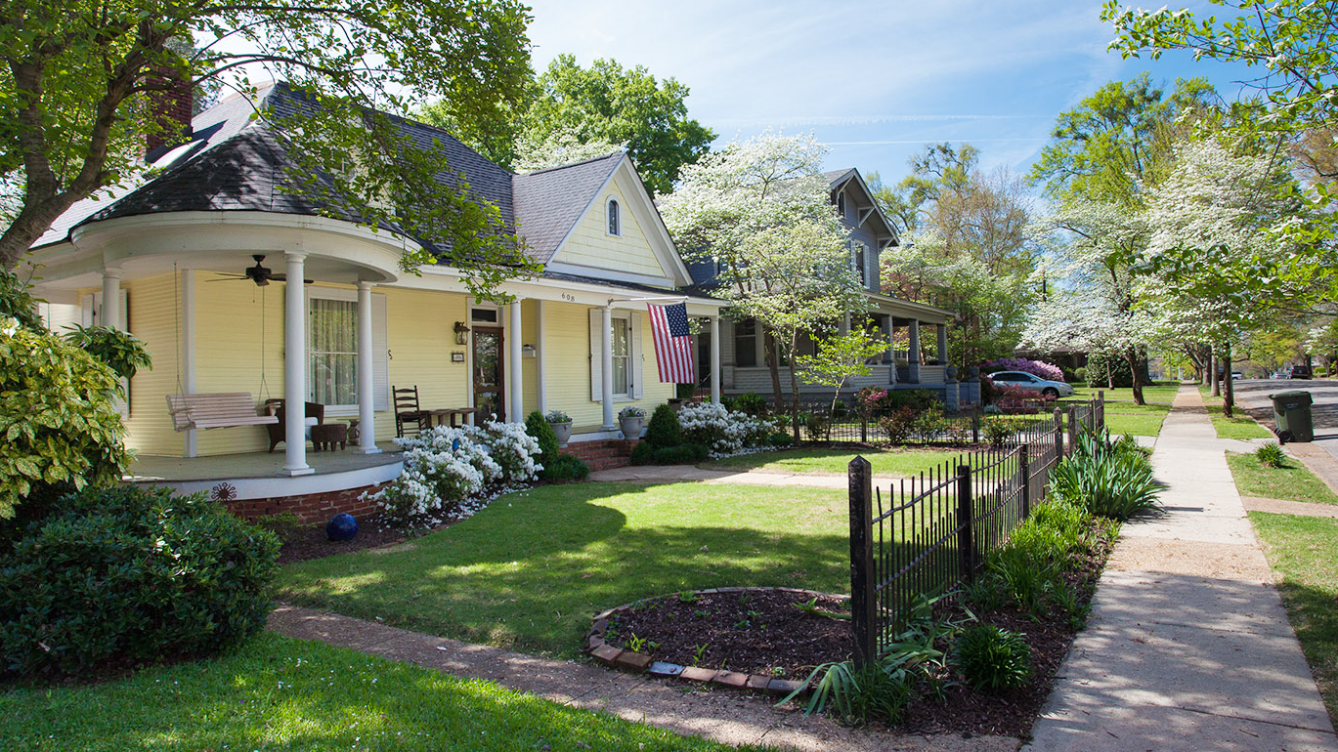
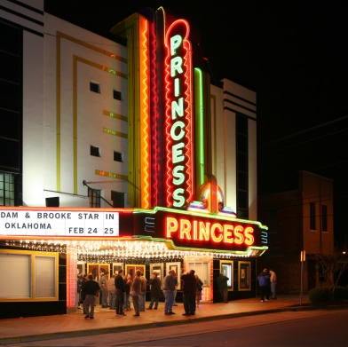
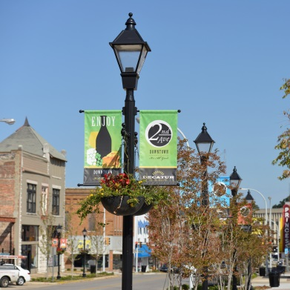
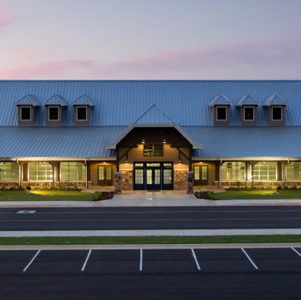


Zoning Ordinance Workshop
Decatur, Alabama
August 18, 2022
OneDecatur.org

Slide 2
AGENDA
Background
Overview of Ordinance
Next Steps

Slide 3
Background

Slide 4
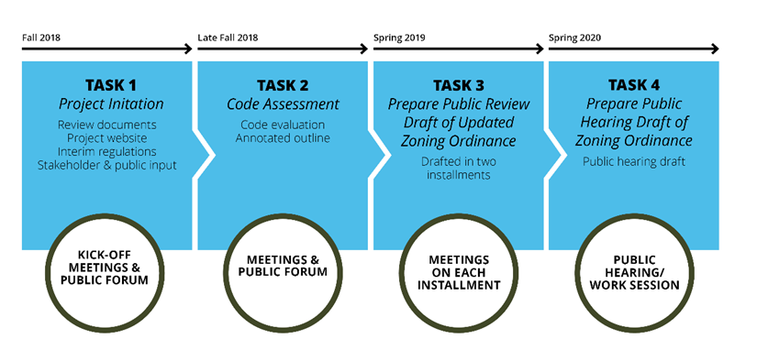
Project Status

Slide 5
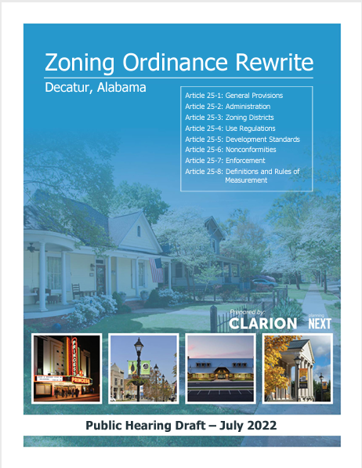
Key Themes
Make the Zoning Ordinance Easier to Use
Implement One Decatur Policies
Modernize Districts and Uses
Improve Quality of Development

Slide 6
Overview of Ordinance

Slide 7
Structure of Zoning Ordinance
Section 25-1 | General Provisions
Section 25-2 | Administration
Section 25-3 | Zoning Districts
Section 25-4 | Use Regulations
Section 25-5 | Development Standards
Section 25-6 | Nonconformities
Section 25-7 | Enforcement
Section 25-8 | Definitions and Rules of Measurement
Appendix A | Submission Requirements for Specific Applications

Slide 8
Section 25-1: General Provisions
Apply to the zoning ordinance generally
NEW Transitional provisions: what happens to ongoing and approved development when the new ordinance takes effect
  Violations Continue
  Pending Applications Proceed under Old Regulations, but at applicant’s option may be subject to New Ordinance
  New Applications Use New Ordinance
  Zoning District Names Converted
25-1.1 | Title
25-1.2 | Authority
25-1.3 | General Purpose and Intent
25-1.4 | Applicability
25-1.5 | Comprehensive Plan
25-1.6 | Relationship with Other Laws, Covenants, or Deeds
25-1.7 | Official Zoning Map
25-1.8 | Transitional Provisions
25-1.9 | Severability
25-1.10 | Effective Date

Slide 9
Section 25-2: Administration
Consolidates all development review procedures
  Summary table of development review responsibilities
  Powers and duties of City Council, Planning Commission, BOZA, other commissions, committees, and staff
    Including Director’s authority to delegate to staff
  Standard (Common) application review procedures
  Procedures for each type of application and review
25-2.1 | Summary Table
25-2.2 | Advisory and Decision-making Bodies
25-2.3 | Standard Application Requirements and Procedures
25-2.4 | Application Specific Review Procedures and Decision Standards

Slide 10
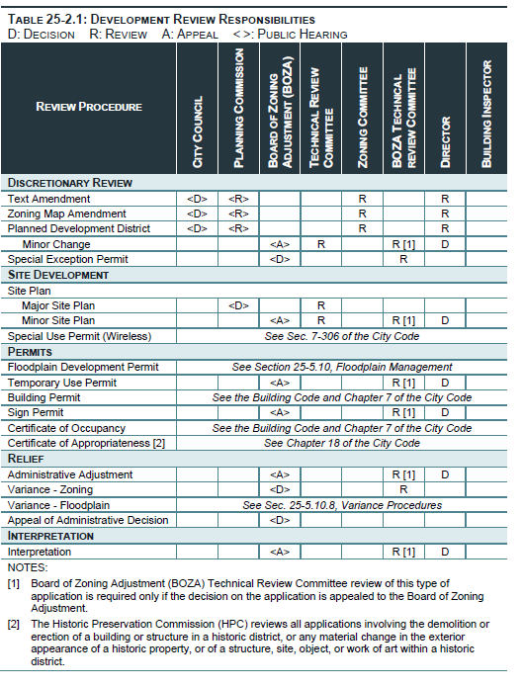
Sec. 25-2.1 Summary Table
NEW
UPDATED
UPDATED
NEW NAME
UPDATED
UPDATED
NEW

Slide 11
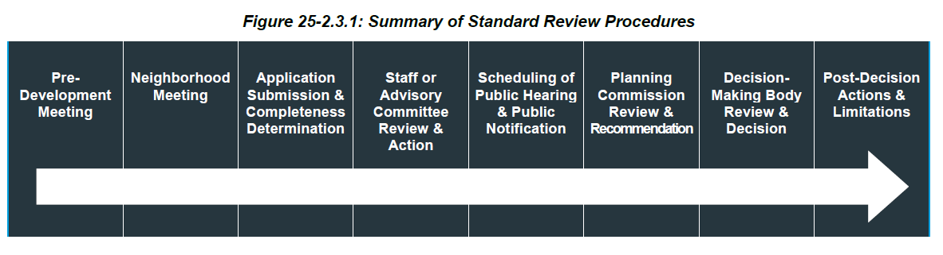
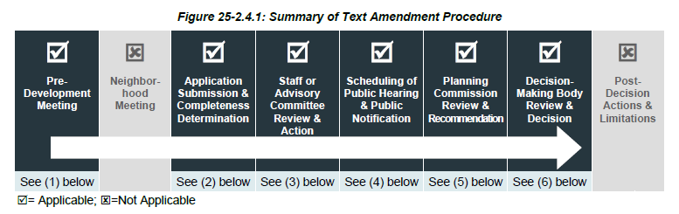
Review Procedure Flow Charts

Slide 12
Section 25-2: Administration
NEW Standardized procedures for neighborhood meetings
  Required before Planned Development, Optional in all others
UPDATED Planned Development now includes details so any minor updates may be administrative
UPDATED Minor Site Plan Approval is administrative
CLARIFIED Major Site Plan includes commercial, industrial, or multifamily residential new construction, unless it will not:
    affect traffic flow
    change building footprint significantly
    negatively affect surrounding residential character, or
    negatively affect drainage.
25-2.1 | Summary Table
25-2.2 | Advisory and Decision-making Bodies
25-2.3 | Standard Application Requirements and Procedures
25-2.4 | Application Specific Review Procedures and Decision Standards
Notes:
Neighborhood Meeting Required before Planned Development, Optional in all others

Slide 13
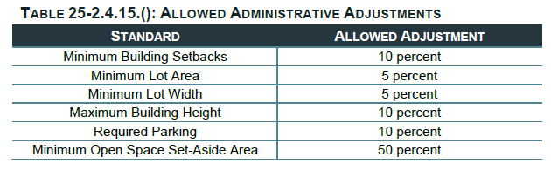
Section 25-2: Administration
NEW Administrative Adjustment allows flexibility through minor changes to measurable standards
UPDATED Variance and Interpretation standards consolidated from many locations to one section each for simplicity
25-2.1 | Summary Table
25-2.2 | Advisory and Decision-making Bodies
25-2.3 | Standard Application Requirements and Procedures
25-2.4 | Application Specific Review Procedures and Decision Standards
Notes:
Neighborhood Meeting Required before Planned Development, Optional in all others

Slide 14
Section 25-3: Zoning Districts
Establishes all zoning districts, and organizes by category:
  Base districts
  Planned Development Districts
  Overlay Districts
Establishes standard user-friendly format
Several types of planned development districts.
25-3.1 | General Provisions
25-3.2 | Base Districts
25-3.3 | Planned Development Districts
25-3.4 | Overlay Districts

Slide 15
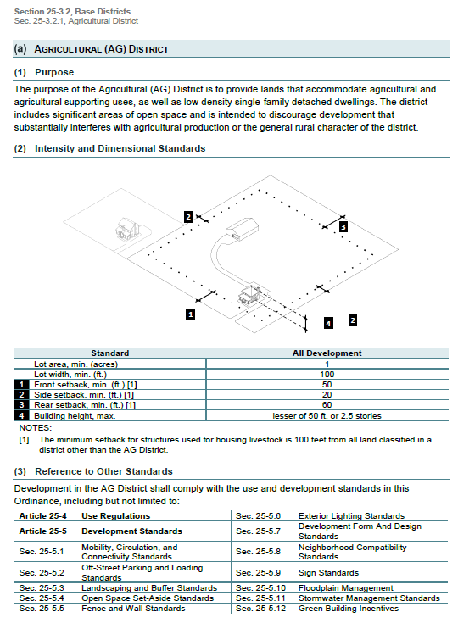
Section 25-3:
Zoning District Format
Purpose statement
Diagram
Intensity and Dimensional Standards Table
References to other relevant standards

Slide 16
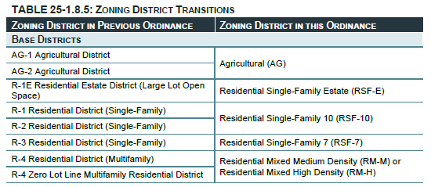
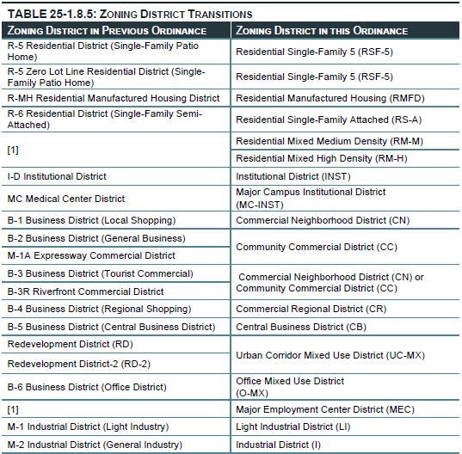
Section 25-3: Zoning Districts (Agricultural & Residential)
Consolidated
Consolidated
Reorganized with a modern medium and high density residential district with lot width and setback dependent on residence type

Slide 17
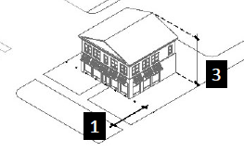
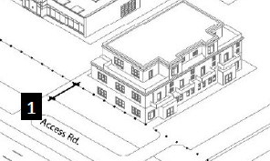
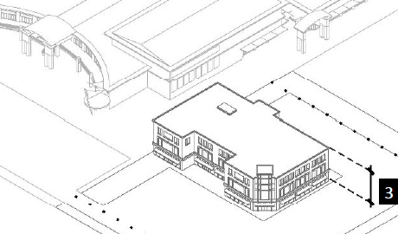
Section 25-3: Zoning Districts
(Nonresidential or Mixed Use)
Reorganized into three commercial districts described by the scale of the markets they serve: Neighborhood, Community, and Regional
Consolidated. Preserves access rules that push development to front 6th Ave. over 7th Ave. when possible

Slide 18
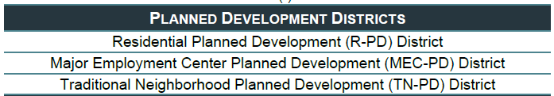
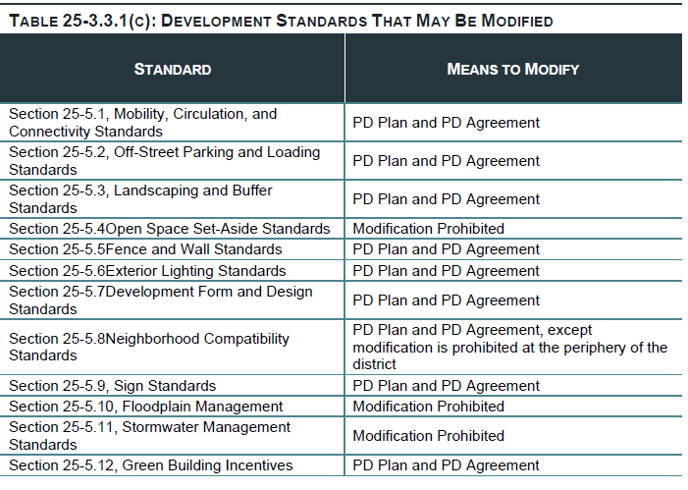
Section 25-3.3: Planned Development Districts
R-PD: allows increase in residential density with higher quality design if consistent with comprehensive plan policies
MEC-PD: flexibility for high-quality, master planned employment uses
TN-PD: vehicle for traditional neighborhood development. Ensures key elements of TND: neighborhood center, walkability, compact form, a mix of uses, higher densities/intensities, strong public realm
Identifies what development standards can and cannot be modified

Slide 19
Section 25-4: Use Regulations
Establishes logical structure for use permissions and standards
  Principal uses
  Accessory uses and structures
  Temporary uses and structures
Unified table for each
Standards for specific uses
Principal uses organized logically by classification, category, and use type
25-4.1 | Organization of This Article
25-4.2 | Principal Uses
25-4.3 | Accessory Uses and Structures
25-4.4 | Temporary Uses and Structures

Slide 20
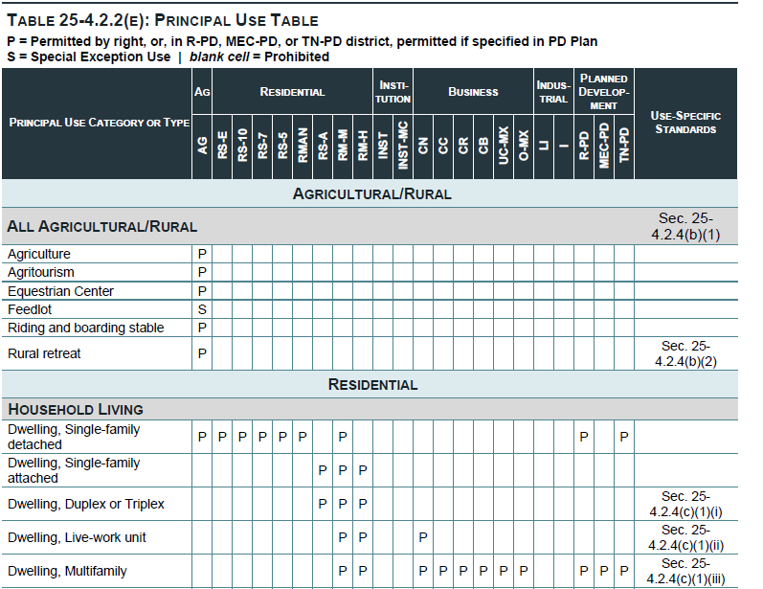
Section 25-4.2: Principal Uses (The Use Table)
Use Specific Standards
All Districts
Use Classification
Use Category
Use Types

Slide 21
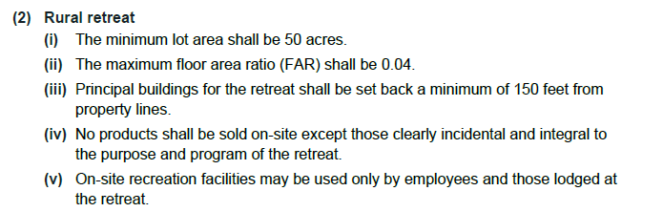
Section 25-4.2: Principal Uses (The Use Table)
Use Specific Standards
All Districts
Use Class
Use Category
Use Types

Slide 22
Section 25-5: Development Standards
Consolidates all development standards into 12 sections
  Basic site design such as parking, landscaping, and open space
  Development features like fences, lights, signs;
  Form and design;
  Technical floodplain and stormwater standards
  Green building incentives
25-5.1 | Mobility, Circulation, and Connectivity Standards
25-5.2 | Off-Street Parking and Loading Standards
25-5.3 | Landscaping and Buffer Standards
25-5.4 | Open Space Set-Aside Standards
25-5.5 | Fence and Wall Standards
25-5.6 | Exterior Lighting Standards
25-5.7 | Development Form and Design Standards
25-5.8 | Neighborhood Compatibility Standards
25-5.9 | Sign Standards
25-5.10 | Floodplain Management
25-5-11 | Stormwater Management Standards
25-5-12 | Green Building Incentives

Slide 23
Sec. 25-5.1: Mobility, Circulation, & Connectivity Standards
Sec. 25-5.2: Off-Street Parking and Loading Standards
Better connected transportation networks
  Minimum Connectivity Index 1.5 in new developments, (measure of nodes and links)
  Requirements to connect to adjacent developments & vehicular cross-access
  Intersection spacing on Highway 20
Updated parking standards
  Minimums for all uses
  Modernized based on best practices
  Large lot standards breaking up the lot and ensuring separate sidewalks
  Parking maximum of 125% of the minimum, but can be exceeded with study
  Minimum bicycle parking (in CB and CR districts only)
Notes:
Focus on Parking, Landscaping, Open space

Slide 24
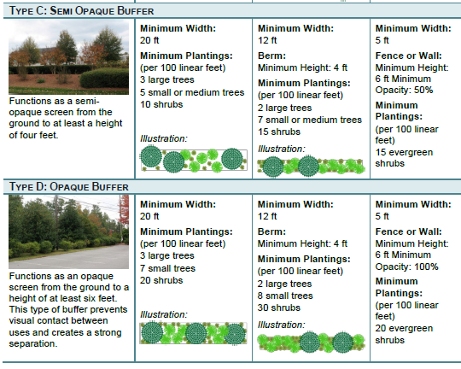
Section 25-5.3.3. Landscaped Buffers
Landscaping given a logical organization: Foundation, Parking lot, and Buffer landscaping standards
  Credit for existing vegetation
New diversity standards requiring between two and four tree and shrub genuses in plantings
Flexibility to meet buffer standards with varying land available
Notes:
Focus on Parking, Landscaping, Open space

Slide 25
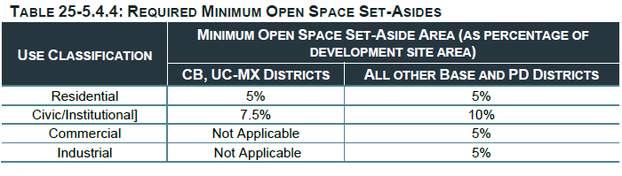
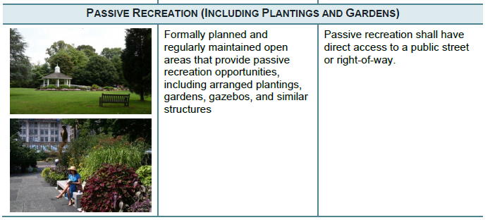
Section 25-5.4: Open Space Set-Aside Standards
Also subject to reduction through administrative adjustment
Graphic examples of types
Exemptions:
  Agricultural
  Single family or two family development on a single lot exempt
  Nonresidential/mixed use on less than one acre
  Development where requirement would be less than 100sf
Areas counted as open space:
  Natural Features
  Active Recreation
  Passive Recreation
  Square and plazas
  Required landscaping or buffers
  Stormwater areas if treated as amenity
  Paths and trails
  Green Roofs
Area that are not counted
  Private yards or access easements
  Parking lots
  Driveways
  Storage areas
Notes:
Add what is or is not open space.

Slide 26
Section 25-5.5 Fence and Wall Standards
Section 25-5.6 Exterior Lighting Standards
Fence and wall standards
  Basic requirements -- location, height, materials, security exception
Exterior lighting standards
  Updated standards – cut-off shields, maximum light levels at property line, “color temperature,” energy efficiency, hours adjacent to single family, security exception

Slide 27
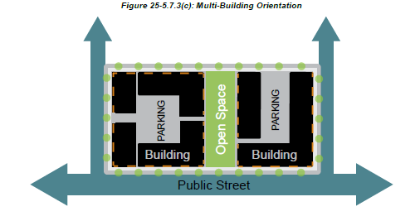
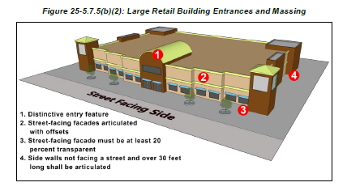
Section 25-5.7 Form & Design
New development form and design standards
  Multifamily
    Limited parking between building and street (20%)
    Building entrances face streets or open spaces
    Individual building length limited to 150 or 250 feet, based on district
    Wall offsets
  Nonresidential
    Building oriented to streets or open spaces
    Façade articulation or offset
  Large retail
    Clearly defined entrances
    Varied façades and massing, fenestration, parking location
    Requires a minimum of 25% of parking be on the side or rear
Notes:
Separate into 1 slide on each (they are new
The maximum length of any multifamily, townhouse, or three-family building shall be 150 linear feet in the RT and RM-M districts and 250 feet in all other districts, regardless of the number of units.

Slide 28
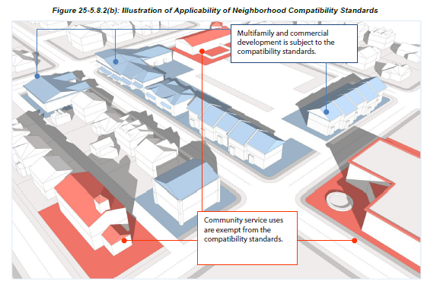
Section 25-5.8 Neighborhood Compatibility
Applies to commercial, mixed-use, and multifamily development (unless exempted) adjacent to single family and two-family development or residential lots
Establishes height, building design, parking location, lighting, buffers, operational, other requirements to protect single-family development
  Height limits based on distance from single- and two-family lots;
    3 stories within 75 feet, 4 stories 75 to 150 feet, etc
  Use a similar roof type to adjacent single-family detached or duplex dwellings in terms of slope and arrangement to prevent abrupt changes in roof form;
  Distance requirements for order boxes for drive-thrus, and location of drive-thrus;
  Location requirements for outdoor dining;
  Limits on hours of operation
  Limits on parking lot locations
Notes:
Separate into 1 slide on each (they are new
Priority list:
Adjacent to off-street parking lots serving nonresidential uses on abutting lots;
Adjacent to lot lines abutting nonresidential development;
Adjacent to lot lines abutting mixed-use development; or
Adjacent to lot lines abutting single-family residential lots.

Slide 29
25-5.9 Signs | 25-5.10 Floodplain Management
25- 5.11 Stormwater Management
25-5.9 Sign standards
  Findings included to support regulations
  Standards generally carried forward
  District-specific standards in tables
  Definitions added and refined (in 25-8)
  Some limits on rope lighting
25-5.10 Floodplain management standards
  Current regulations carried forward
25-5.11 Stormwater management standards
  Current requirements for stormwater detention facilities and erosion and sedimentation control carried forward

Slide 30
Section 25-5.12: Green Building Incentives
Incentives available to applicants:
  Additional height (1 story residential, 2 stories nonresidential or mixed use)
  Additional lot coverage (15 percent)
  Parking reduction below minimum or increase above maximum without an alternative plan (15 percent)
Flexible, menu-based approach for different features
  Energy conservation
  Alternative energy
  Green building certification
  Water conservation and water quality
  Vegetation
  Urban agriculture
  Building materials
  Transportation
  Resiliency to natural hazards
Must have a combination of different features to get incentive
May pursue multiple incentives, but no double counting from the menu

Slide 31
Section 25-6: Nonconformities
Existing development or features that do not conform to the requirements of the new code can legally continue
Consolidates rules for nonconforming uses, structures, lots, and signs in one place
Provisions addressing nonconforming site features (for parking and landscaping)
25-6.1 | General Applicability
25-6.2 | Nonconforming Uses
25-6.3 | Nonconforming Structures
25-6.4 | Nonconforming Lots of Record
25-6.5 | Nonconforming Signs
25-6.6 | Nonconforming Site Features
    Scale compliance based on the amount of expansion of the building or the value of the remodeling that takes place.
Notes:
Bullet on scaled compliance.

Slide 32
Section 25-7: Enforcement
Consolidates rules governing enforcement into one article
Identifies the actions that result in a violation of the zoning ordinance
Identifies the persons who will be held responsible for violations
Authorizes the City officials responsible for enforcement of the Ordinance and the procedures used for enforcement
Identifies the remedies and penalties available to the City for violations, and that they are cumulative
25-7.1 | Purpose and Intent
25-7.2 | Compliance Required
25-7.3 | Violations
25-7.4 | Responsible Persons
25-7.5 | Enforcement Generally
25-7.6 | Remedies and Penalties

Slide 33
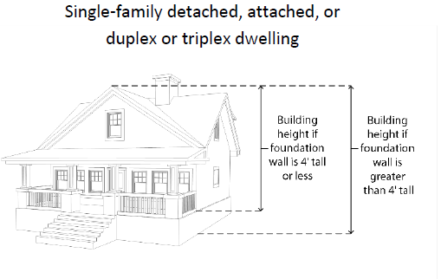
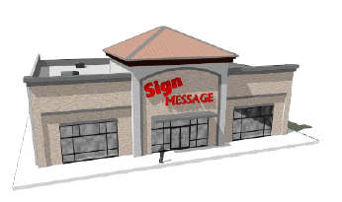
Section 25-8: Definitions and Rules of Measurement
General rules include how to interpret language in code, calculate time, etc. authorizes delegation of authority by Planning Director
Rules of measurement include how to measure – height, setbacks, calculate building size, density, lots, etc.
  Includes exceptions to setbacks and height
Definitions have been consolidated, updated for clarity, and new definitions added, where appropriate. Include a definition for every use type in the code.
  Floodplain-related definitions still separate for ease of state and federal program review.
  Sign definitions include graphics
25-8.1 | General Rules for Interpretation
25-8.2 | Rules of Measurement
25-8.3 | Definitions

Slide 34
Appendix A: Submission Requirements for Specific Applications
Specific requirements for site plans and building permits placed in appendix
Makes the ordinance easier to read

Slide 35
Next Steps

Slide 36
Council and Commission
Questions and Comments
OneDecatur.org

Slide 37
Next Steps
Set zoning ordinance for adoption at public hearing

