Slide 1
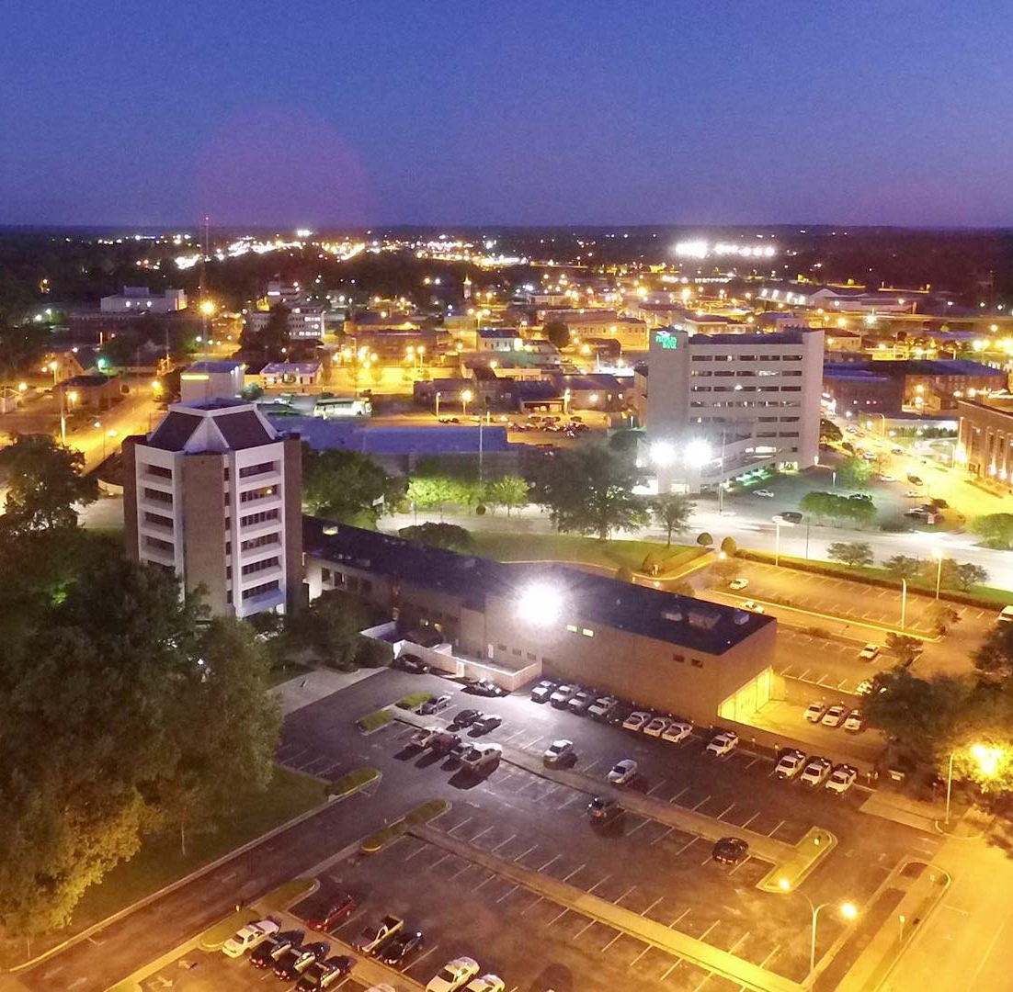
One Decatur 2022 Annual Update
Planning Commission Meeting
January 18th, 2022

Slide 2
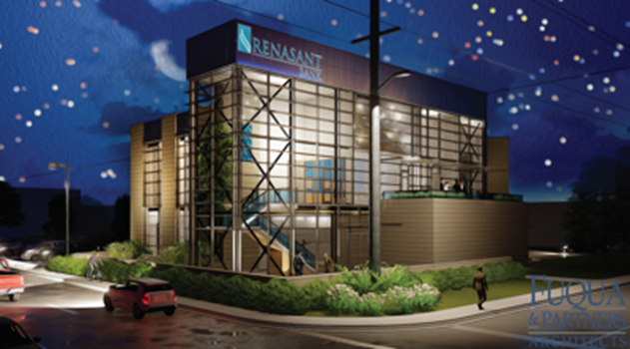
Commercial Development
Related to multiple objectives under Advancing Our Prosperity.
20 Commercial Site Plans reviewed by the Planning Commission in 2021.
The most since our digital logbook started in 1998.
These Site Plans included:
New Family Security Credit Union Office
Crunch Fitness (with additional retail space)
Hernandez Fitness Center
Watercress Car Wash
A Distribution Center on Bibb Garrett Rd
Culver’s Restaurant
Renasant Bank
Valvoline Oil Change
Windmill Beverages
Huracan FC Soccer Complex

Slide 3
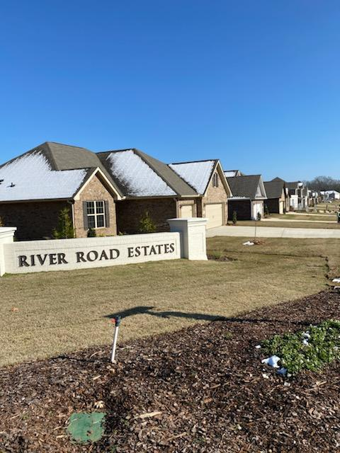
Residential Development
Related to multiple objectives in Quality Place and Advancing Our Prosperity
Subdivisions reviewed and accepted by the Planning Commission in 2021 included over 600 lots.
The total over the past 2 years is now approximately 900 lots.
The homes built in the new subdivisions will range from townhomes to large homes on estate-sized lots and even a few riverfront properties.
Two new subdivisions, totaling about 77 acres were annexed into the City in the past year.

Slide 4
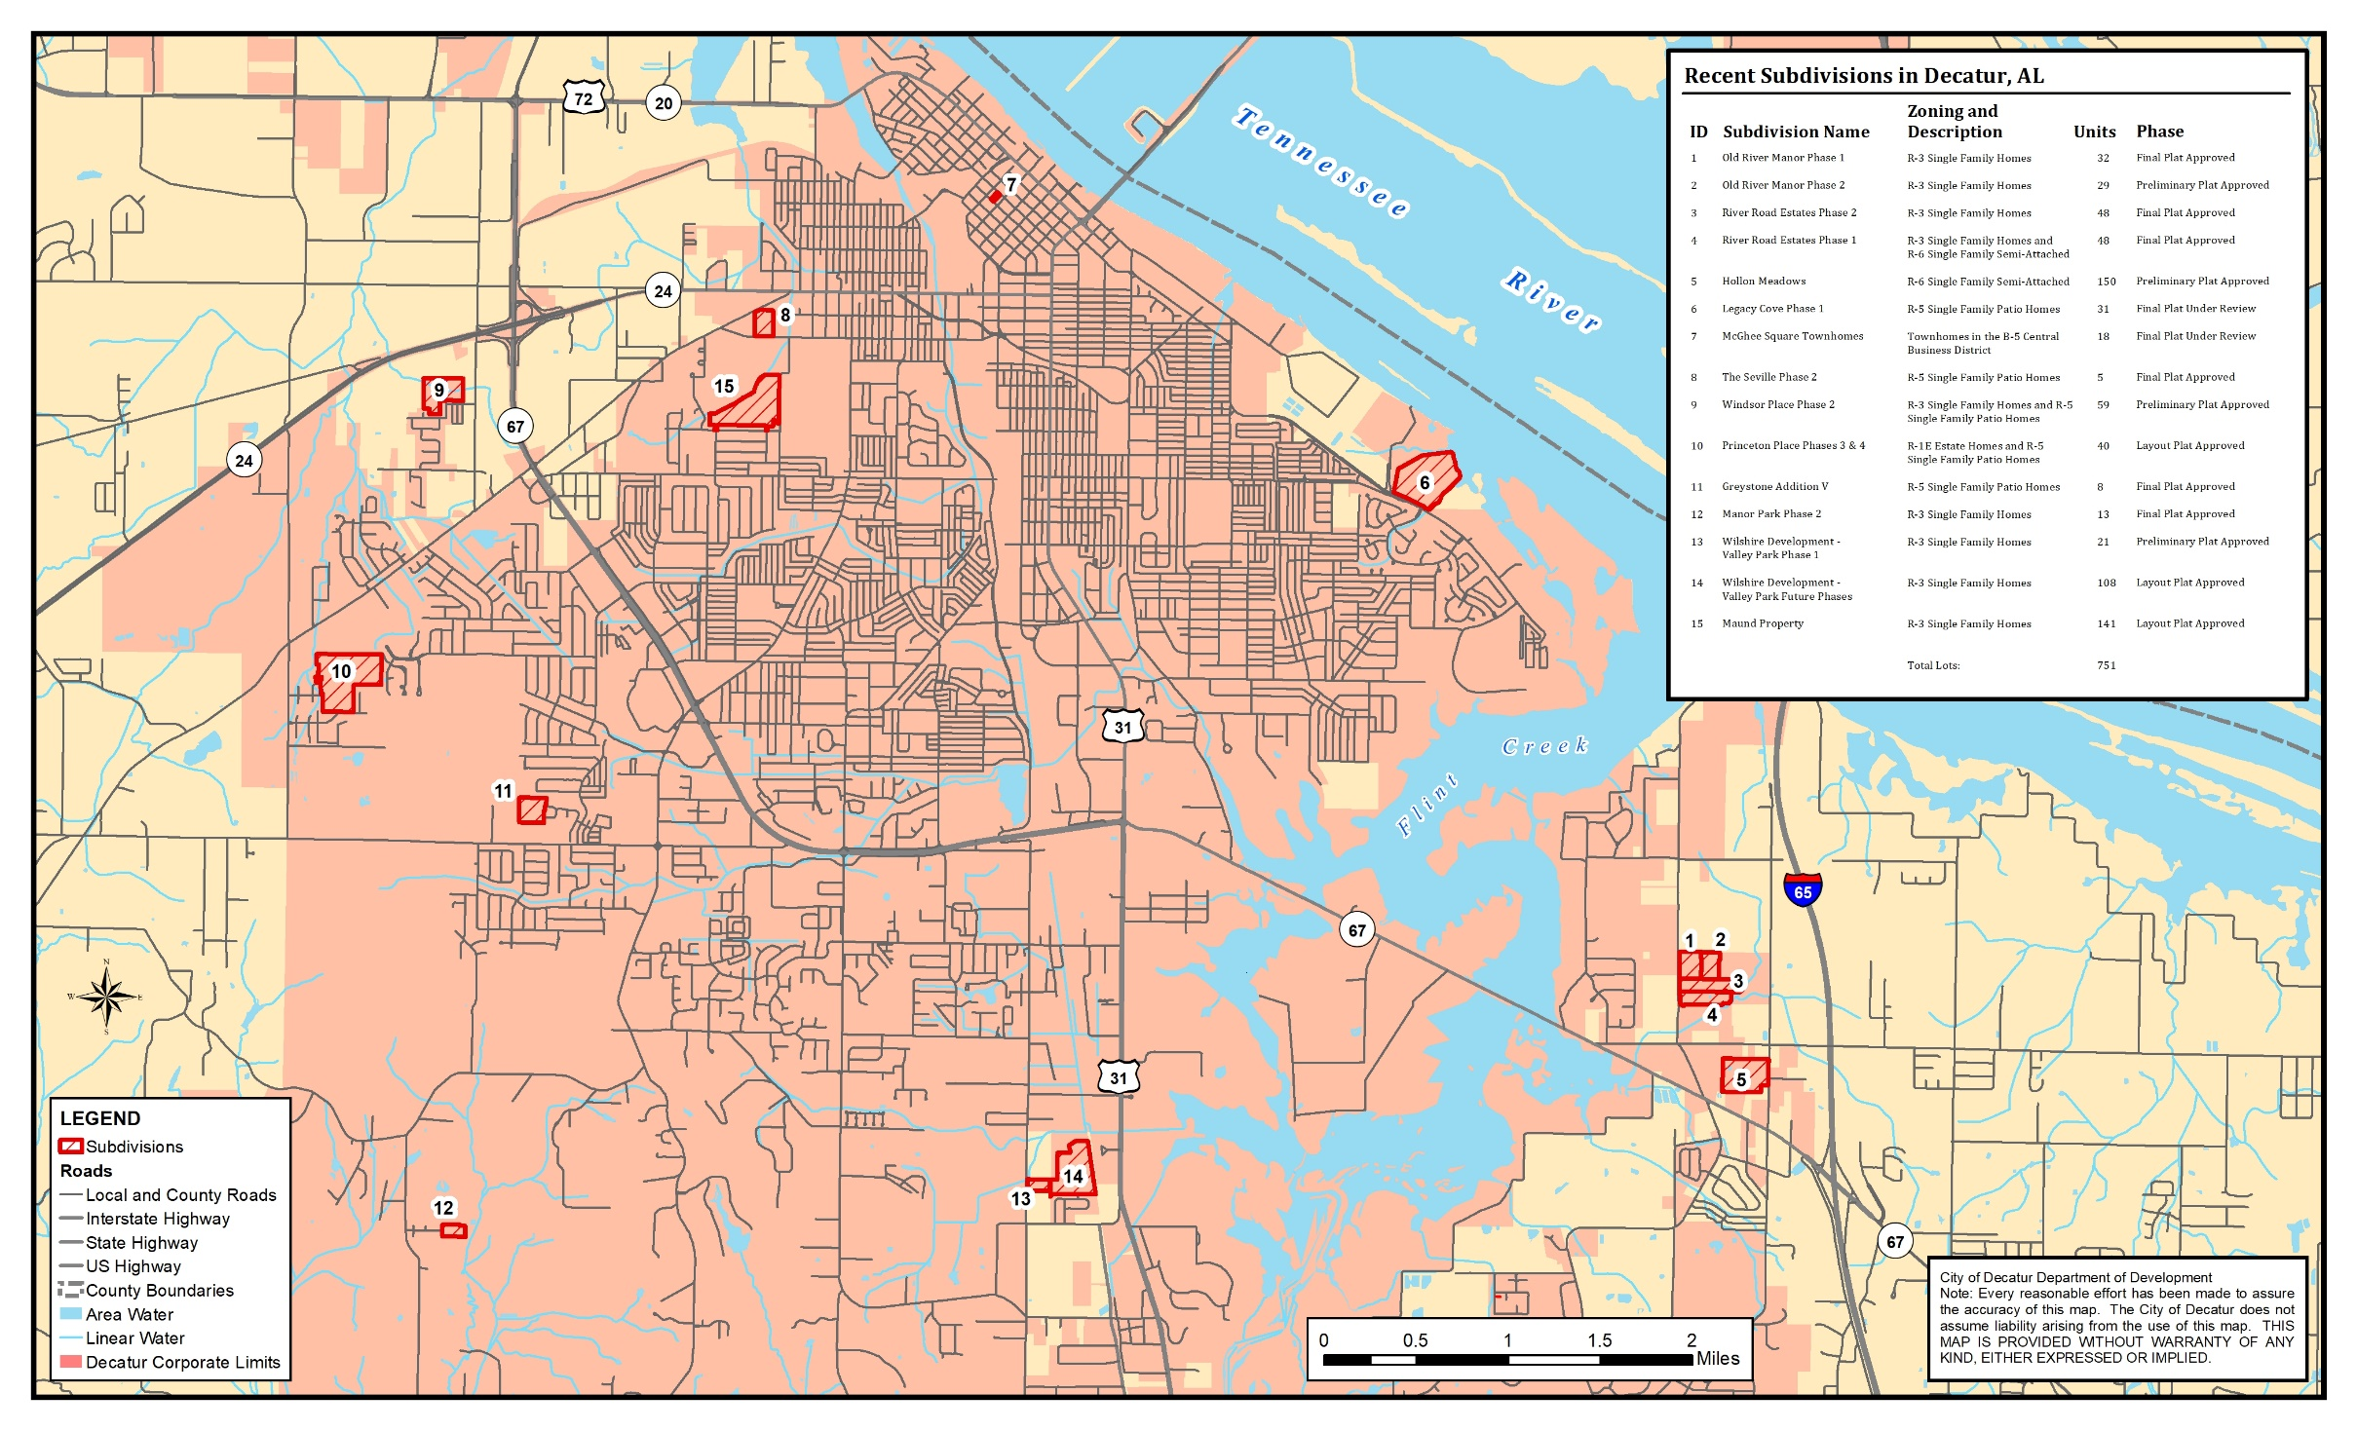

Slide 5
Downtown Development
QP 6.1 Facilitate Downtown Development and PR 4.4 Facilitate Downtown Housing Development
Current developments:
Fairfield Inn Hotel at Moulton St and 2nd Ave announced
Downtown Parking deck to serve hotel and add 150 public spaces
Alabama Center for the Arts Dormitories
Renasant Bank
McGhee Square Townhomes
Future developments:
Possibly a new rec center and development of the Decatur Downtown Commons
Additional residential development downtown has been discussed
Upscale apartments
Mixed-use developments

Slide 6
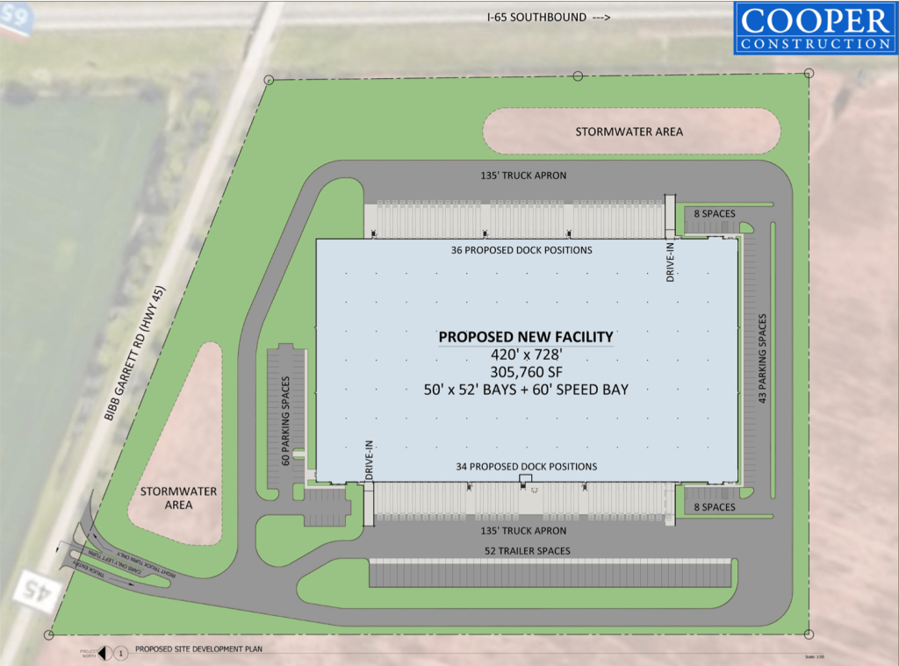
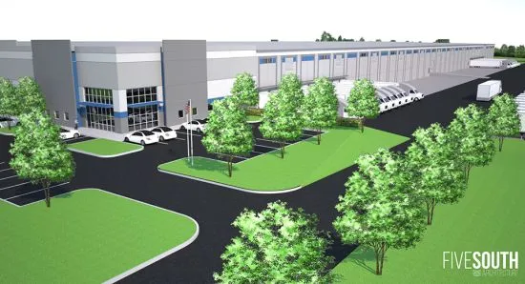
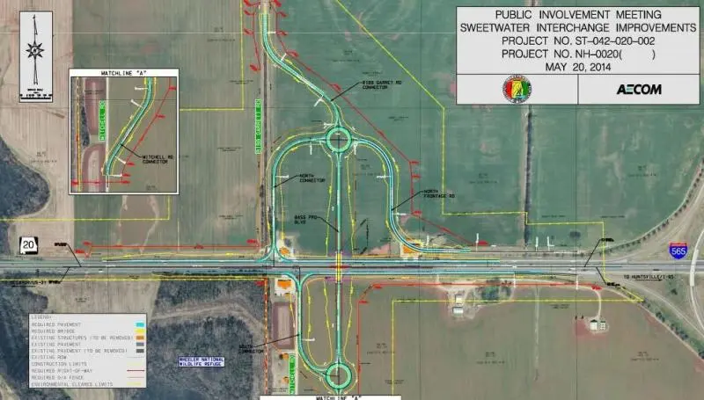
Highway 20 Development
PR 4.2 Facilitate North of the River Development.
The Highway 20 Corridor is primed for development.
The Mazda-Toyota plant opened in September.
The new overpass is under construction.
A new distribution center is nearing completion on Bibb Garrett Rd West of I-65.
Road improvements and utilities projects are being planned to further enable development.

Slide 7
Zoning Ordinance Rewrite
QP 1.1 Reform the City’s zoning and land development codes
QP 2.5, 3.1, 5.1-5.4, 9.2; MO 1.2, 2.3; PR 4.1; VI 3.1
The Zoning Ordinance touches on many objectives throughout the plan.
Progress made in 2021:
Module 2 Public Review Document was completed.
The Planning Staff reviewed the document.
The Zoning Rewrite Steering Committee reviewed, added comments, and met in August 2021.
Next steps:
Prepare final document.
Hold a public meeting.
Get approval from Planning Commission and City Council.
Goal of Summer 2022 for adoption of the new ordinance.

Slide 8
Improving our mobility
MO Objective 1: Design street improvements to balance mobility, accessibility, land use, and desired development character; and MO Objective 2: Improve the appearance and condition of the City’s streets
The City Council approved a contract with Volkert for engineering and design on the 6th Ave Improvement Project.
MO Objective 3: Increase efforts to make the city more walkable and bike friendly
MO 3.1 - The Engineering Department continues to allocate $100,000 each year to sidewalk repair. They have a prioritized list of curb ramps that need to be repaired and use that funding to do repairs in the highest priority areas.
MO 3.2 – DMCT is working with Alta and the Singing River Trail on new brochures and vision board for the urban trail system which will show suggested improvements.
MO 3.4 – DMCT is working with a company to develop interactive maps for the urban trail system that will also highlight nearby attractions. The maps will increase awareness and provide information for urban trail users.
MO 6.1 Plan for a new bridge
The city continues to seek funding for another river crossing west of the current bridge on Highway 31. The City has hired a lobbyist to assist in the search for funding for the project.

Slide 9
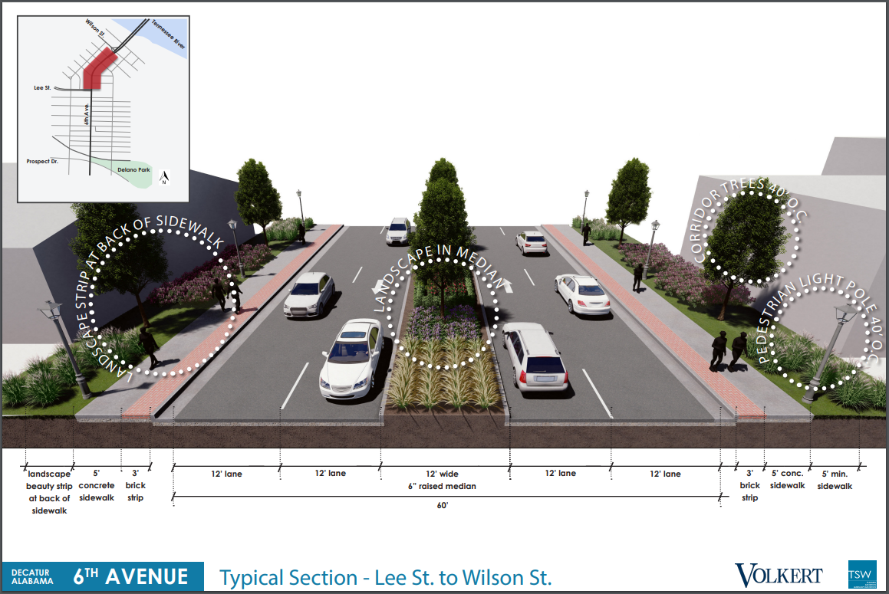
Improving our mobility

Slide 10
Other Updates
Improved Internet Access
AM 1.1 Establish partnerships to improve access to high speed internet.
AM 1.2 Evaluate the feasibility of establishing public wi-fi in key locations.
Joe Wheeler has begun installing their FlashFiber in their service areas, which includes some parts of Decatur and the surrounding area.
The Downtown Decatur public wi-fi project has been successful and has continued from the pilot program that started over a year ago.
PR 1.4 Create Regulatory fast-track program
ZTAs to allow administrative approval for Home Occupations and Temporary Businesses are being reviewed now to allow people wanting to start these types of businesses to do so without going through BOZA.
QP 8 Maintain Historical Assets and QP 4.1 Develop a “maintain, revitalize, redevelop program for neighborhoods”.
Caroline Swope, Historic Preservation Specialist, has been reaching out to assist property owners with historic tax credits. Decatur is the only city in the state that does this. To date, if all of the approved projects proceed, Caroline has located approximately $3,500,000 in historic tax credits for property owners, equaling a $7.9 million dollar investment in our historic properties.

Slide 11
Other Updates
CO 1.5: Continue to emphasize career and vocational education
DCS will be breaking ground in the spring on a new Career Academies of Decatur building which will give students more resources to learn career skills. It will include heavy equipment simulators along with classroom space for an EMT section, medical career facility, engineering program, and computer labs. The new building will also provide more space for the programs the Career Academies offer and free up additional space at the current location.
PR 6.1: Conduct a Summit on Collaborative Branding
The City Council has approved an annual contract with Red Sage to work on a marketing campaign for the City of Decatur. Red Sage is a local company that wants to help Decatur "Tell its own story" and highlight all the positive things going on in and around the City right now.
For a complete list of updates, see the 2022 One Decatur Update document.

Slide 12
Overall Status of objectives
All Objectives | Count | Percent
Complete | 2 | 1%
Complete and Ongoing | 46 | 33%
Ongoing | 65 | 46%
Underway | 10 | 7%
Initiated | 2 | 1%
Future | 16 | 11%
Total | 141 | 100%

Slide 13
Re-evaluate future land use
As requested by the Planning Commission in December, we have created Land Use Maps for their review.
On the upcoming slides…
The Land Use Map from the One Decatur Comprehensive Plan (2018).
The Current Land Use Map (next slide) shows the current land use.
The map is based on Zoning, with some minor changes where the zoning did not match the actual land use (i.e. a church in residential, commercial use in Industrial Zone, etc.).
Since it is based on zoning and ownership parcels, it is a somewhat generalized map.
This map shows the current state and can be used to identify changes that have been made and determine their consistency with the One Decatur Plan.
The Future Land Use Map is exactly what was in the One Decatur Plan from 2018.
Review this map and see if any updates are needed at this time.

Slide 14
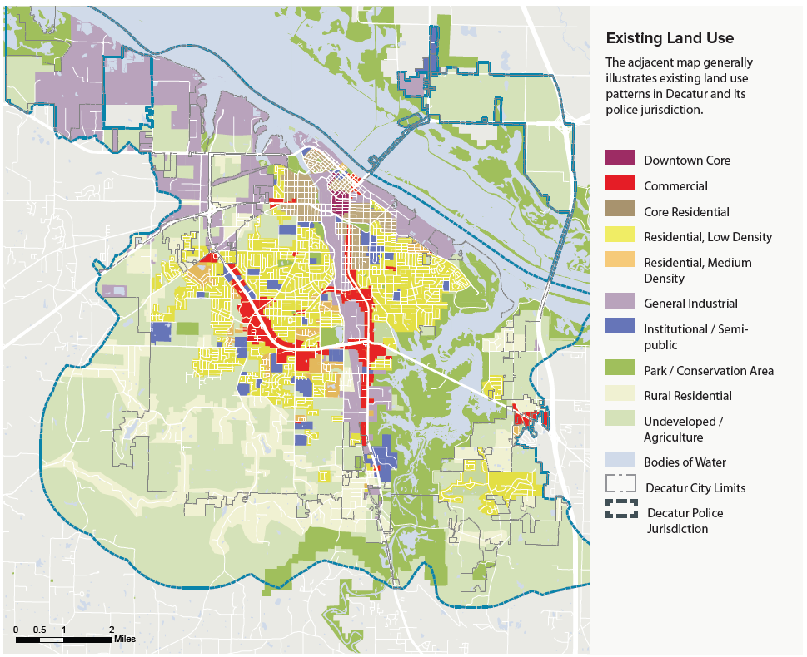

Slide 15
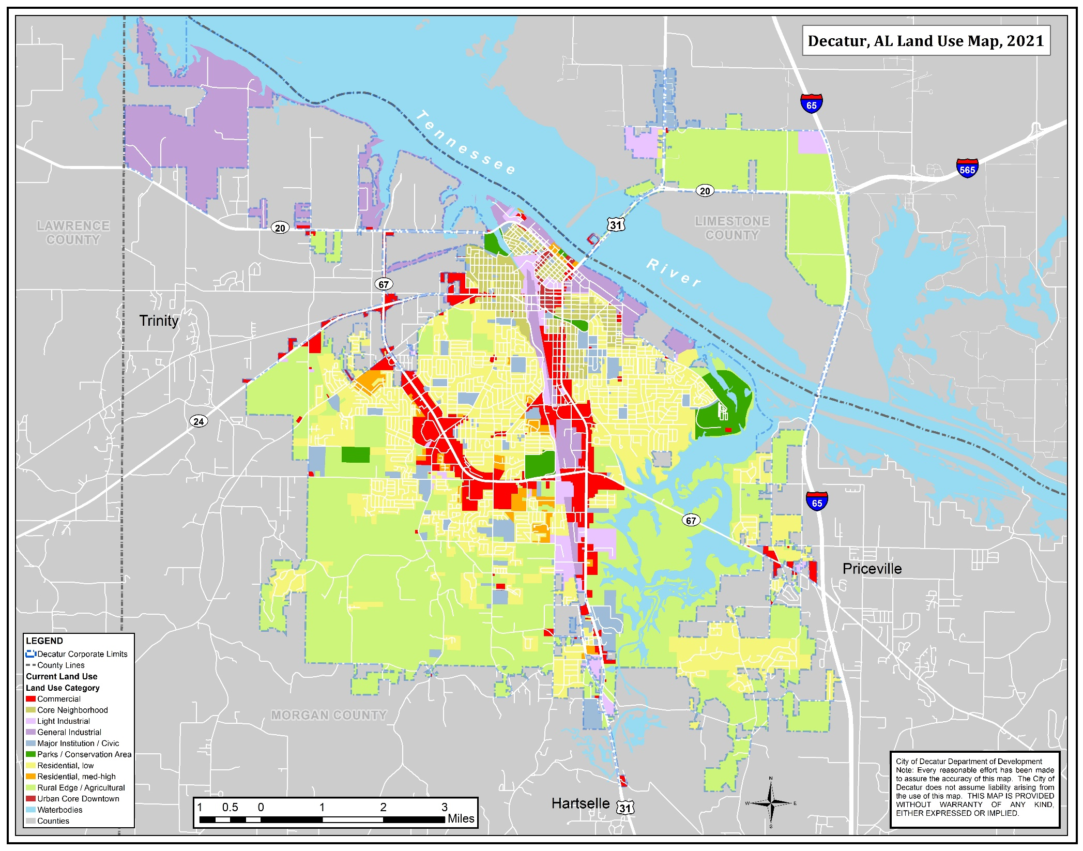

Slide 16
